Slide 1
Disaster Recovery with IBM Cloud Virtual Servers
Presented by,
R.divya
E.Janani
r.r.Kanishka
p.kavisri
p.vinothini

Slide 2
Disaster Recovery Strategy
Certainly, here's a streamlined Disaster Recovery Strategy for the IBM Naanmudhalvan Project
Risk Assessment and Planning: Identify potential risks, assess their impact, and develop a disaster recovery plan.
Data Protection and Testing: Implement data backup and redundancy mechanisms while regularly testing the recovery plan for readiness.

Slide 3

Disaster Recovery Strategy
Risk Assessment
Business Impact Analysis
Backup and Data Protection
Redundancy and Failover
Data Replication
Cloud-Based Solutions
Disaster Recovery Plan
Testing and Training

Slide 4
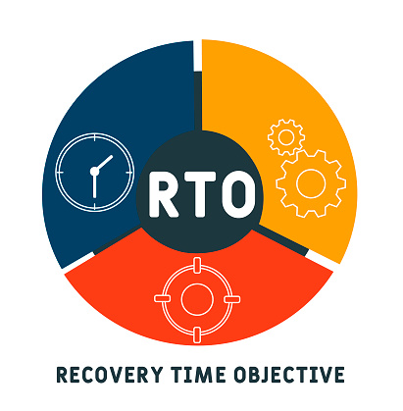
Recovery Time Objective (RTO)
Recovery Time Objective (RTO) for the IBM Naanmudhalvan Disaster Recovery Project is the predetermined maximum acceptable downtime for critical systems and services.
Specific Timeframe: The RTO for this project is set at Specific signifying the time allowed for recovery and restoration of essential components after a disaster or disruption.
Operational Continuity: Our commitment to achieving RTO ensures the project's operational continuity and minimal disruptions in the face of unforeseen events.

Slide 5

Recovery Point Objective (RPO)
RPO, or Recovery Point Objective, specifies the maximum allowable data loss in the event of a disaster or disruption.
Specific Timeframe: The RPO for this project is set at [Insert Specific Timeframe, e.g., 1 hour], indicating the maximum acceptable age of data when it is recovered.
Data Loss Minimization: Adhering to this RPO ensures that our project can recover data with minimal loss, helping to maintain data integrity and operational continuity during adverse events.

Slide 6

Priority of Virtual Machines
It is a key element in disaster recovery planning and helps determine the order in which VMs should be restored or brought back online in the event of a disaster or disruption.
Critical VMs (Priority 1)
High-Priority VMs (Priority 2)
Medium-Priority VMs (Priority 3)
Low-Priority VMs (Priority 4)

Slide 7

Recovery Sequence
The recovery sequence in the context of disaster recovery planning can be summarized in two points.
Prioritize Critical Systems: Begin by prioritizing and recovering critical systems and services first to minimize downtime and ensure the most essential functions are operational as quickly as possible.
Progressive Restoration: After critical systems are restored, proceed with the recovery of less critical systems and data, following a predetermined order or hierarchy based on their importance to the organization's operations.

Slide 8
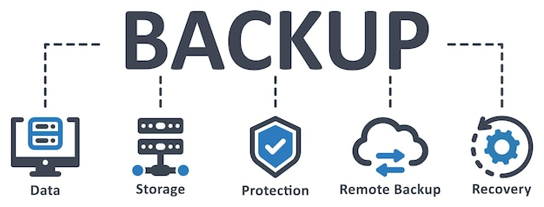
Backup Tools
Veeam Backup & Replication
Veritas NetBackup
Commvault
Acronis Backup
Backup Exec
Rubrik
Druva
IBM Spectrum Protect
SolarWinds Backup
Azure Backup

Slide 9

Coding
import shutil
import os
import time
source_directory = "/path/to/source/data“
backup_directory = "/path/to/backup/data"
recovery_directory="/path/to/recovery/destination"
def backup_data():
try: timestamp = time.strftime("%Y%m%d%H%M%S")
backup_folder = os.path.join(backup_directory, "backup_" + timestamp)
os.makedirs(backup_folder)
shutil.copytree(source_directory, backup_folder)
print(("Backup completed successfully.")

Slide 10

Coding
except Exception as e:
print("Backup failed: " + str(e))
def restore data():
try:
print("Initiating data recovery...")
latest_backup = max(os.listdir(backup_directory), key=os.path.getctime) source_backup_folder = os.path.join(backup_directory, latest_backup) shutil.copytree(source_backup_folder, recovery_directory)
print("Data recovery completed successfully.")
except Exception as e:
print("Recovery failed: " + str(e))
def disaster_recovery():

Slide 11

Coding
backup_data()
if disaster_occurred:
restore_data()
except Exception as e: print("Disaster recovery failed: " + str(e))
disaster_occurred = True
Output:
Initiating backup...
Backup completed successfully.
Initiating data recovery...
Data recovery completed successfully.

Slide 12


